Slide 1
Sales Perfomance Dashboard of GeoHorizon Research
File created on: 08/10/2022 8:40:49 AM

Slide 2
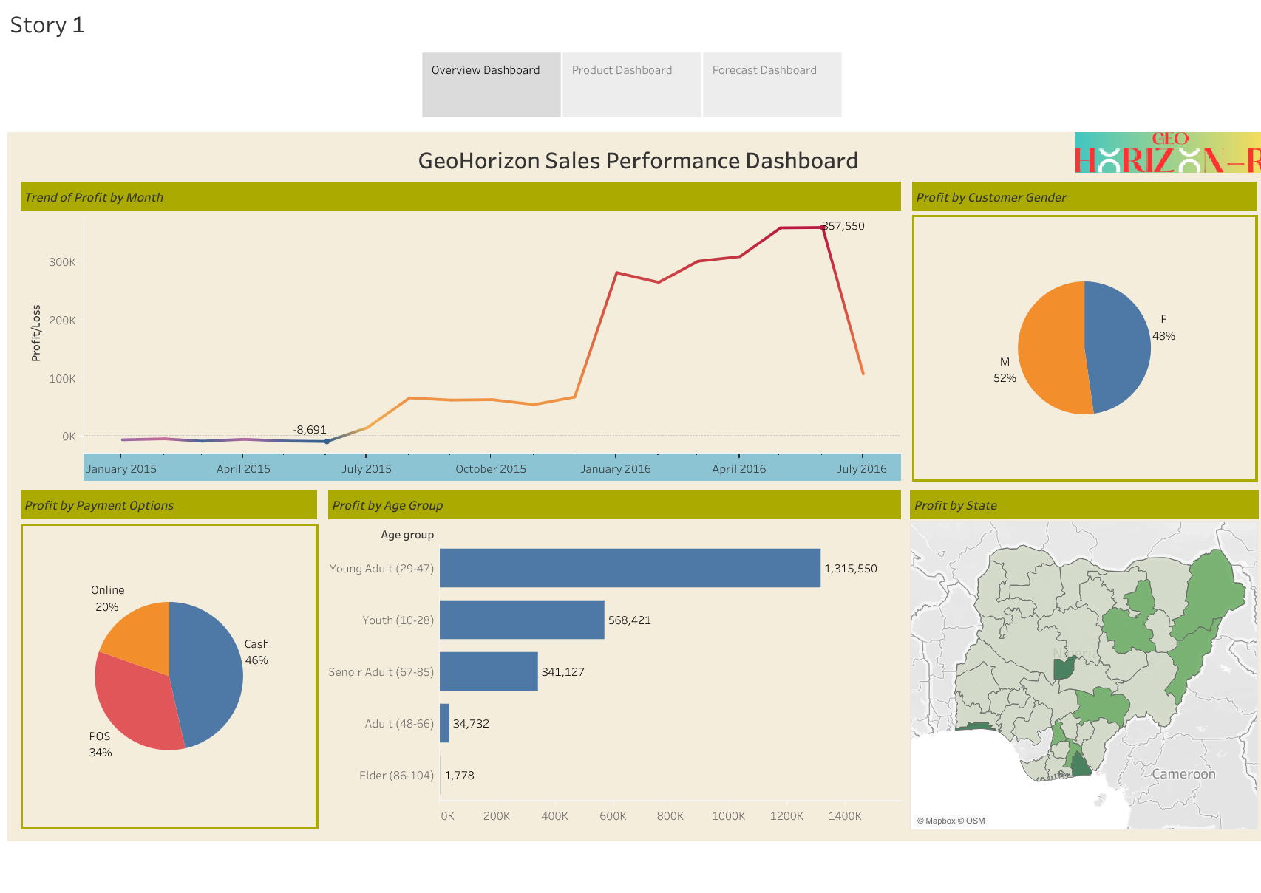

Slide 3
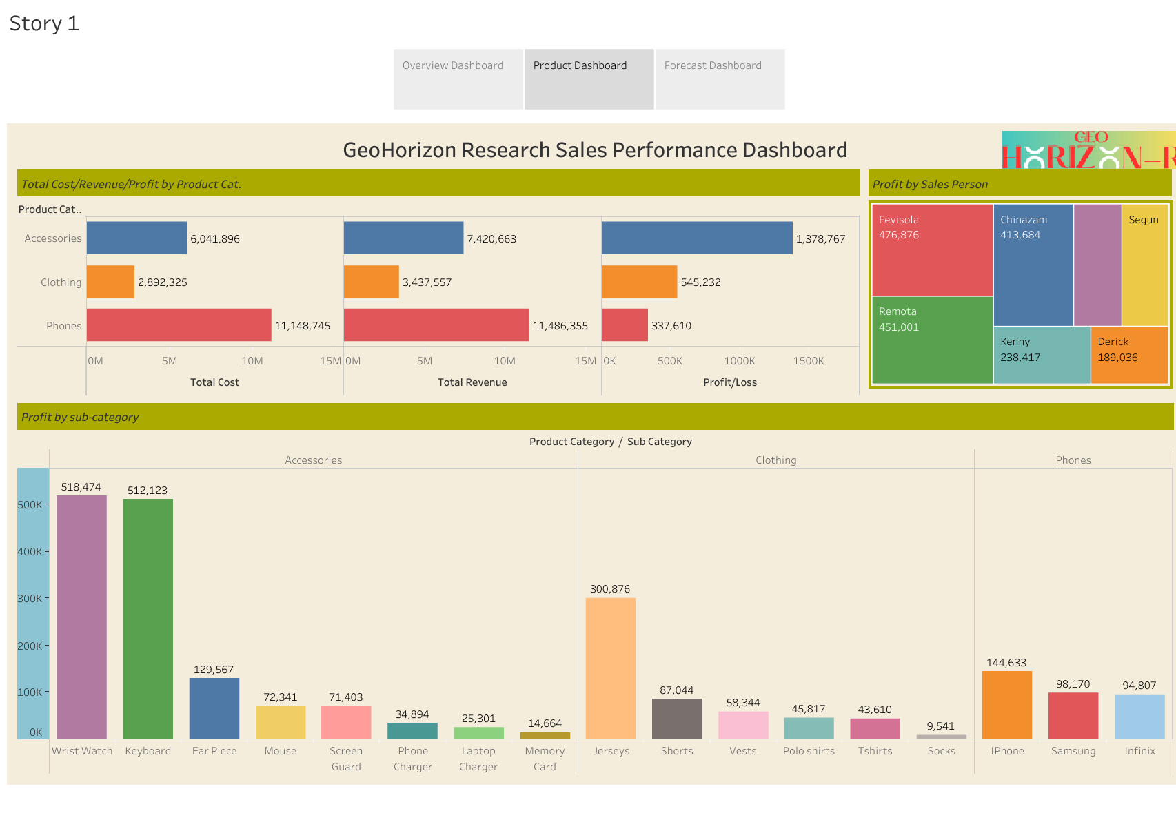

Slide 4
